Slide 1
CHM 5175: Part 2.8
Transient Absorption
Source
Source
hν
Detector
hν
Sample
Ken Hanson
MWF 9:00 – 9:50 am
Office Hours MWF 10:00-11:00

Slide 2
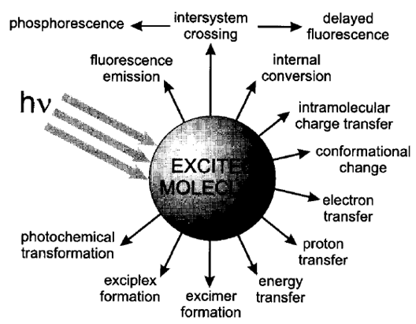
Excited State Decay
Steady-state Emission
Time-resolved Emission
Absorption Spectroscopy
NMR
Mass-spec
x-ray…
Non-radiative Decay

Slide 3
Events in Time
Photochemistry
Isomerization
Excitation
Intersystem Crossing
Fluorescence
Phosphorescence
Internal Conversion
1 fs
1 ps
1 ns
1 μs
1 ms
1 s
femto
pico
nano
micro
milli
seconds
0.000 000 001 s
0.000001 s
0.001 s
1 s
0.000 000 000 001 s
0.000 000 000 000 001 s

Slide 4
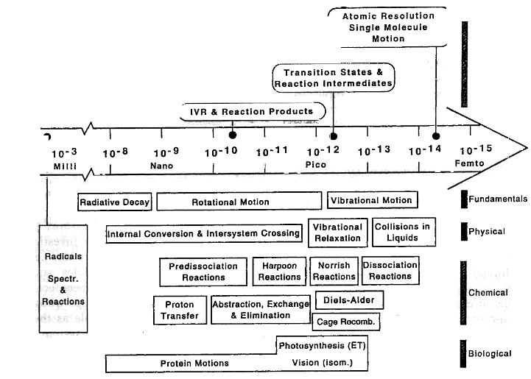
Events in Time

Slide 5
Transient Absorption Spectroscopy
Source
S₂
Source
hν
Detector
S₁
hν
T₂
E
T₁
Sample
S₀
Transient Absorption
1) High intensity pulse of light.
2) Monitor absorption spectrum over time.
Excitation
Internal Conversion
Fluorescence
Non-radiative decay
Intersystem Crossing
Phosphorescence

Slide 6
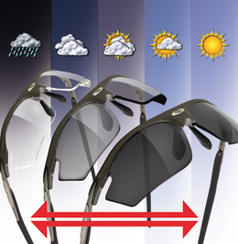
Transient Absorption Spectroscopy
TA of Photochromic Sunglasses
(seconds to minutes)
Steps
1) Excitation (sunlight)
2) Go inside
3) Monitor color change over time

Slide 7
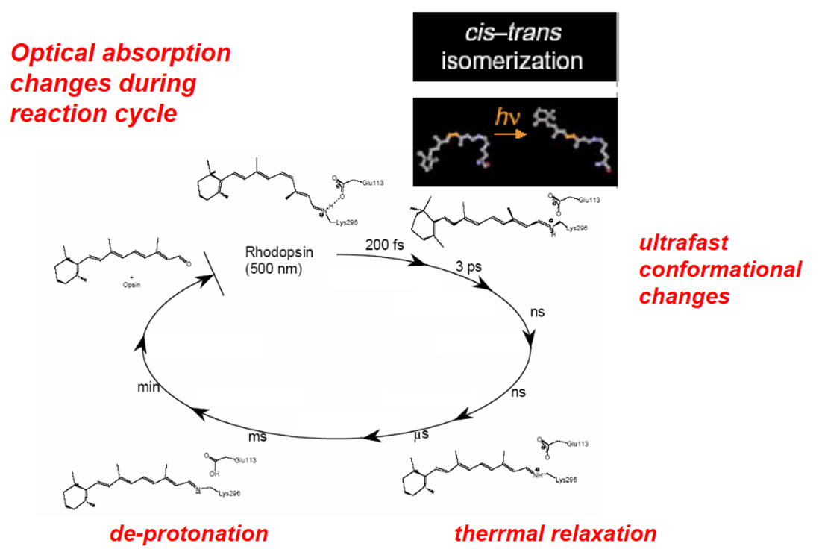
Transient Absorption Spectroscopy

Slide 8
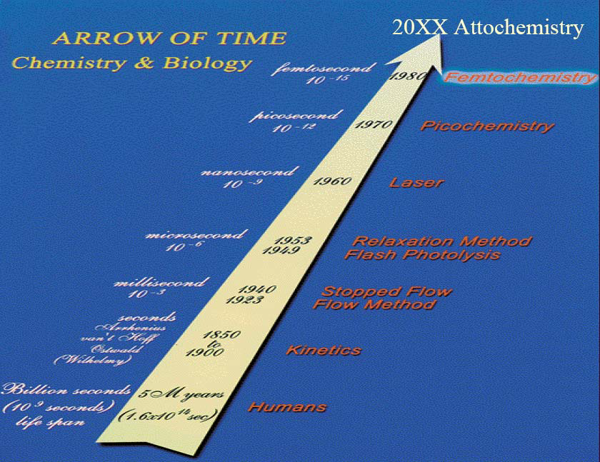
Spectroscopy Timeline

Slide 9
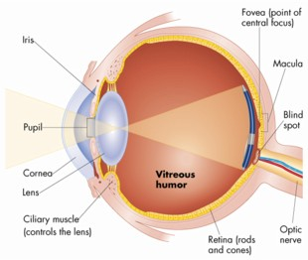
Visual Spectroscopy
“The human eye and its brain interface, the human visual system, can process 10 to 12 separate images per second (10 Hz), perceiving them individually.”
100 ms or 0.1 s
10 ms or 0.01 s
Time
Time
Perceived as green and then red.
Perceived as yellow.

Slide 10
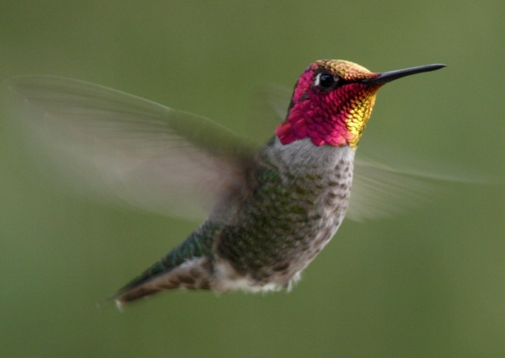
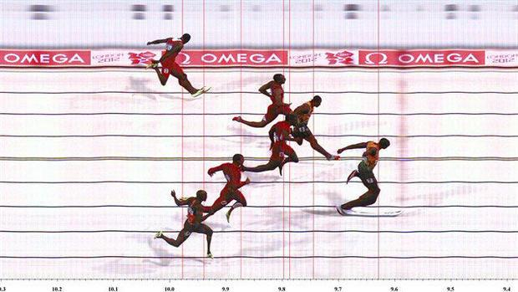
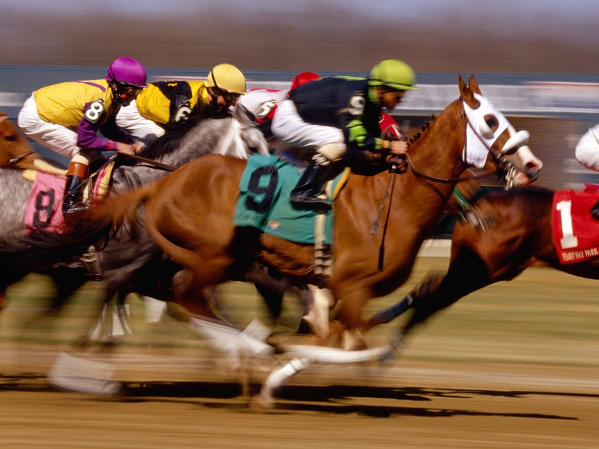
We are missing out!
70 Hz
14 ms per cycle

Slide 11
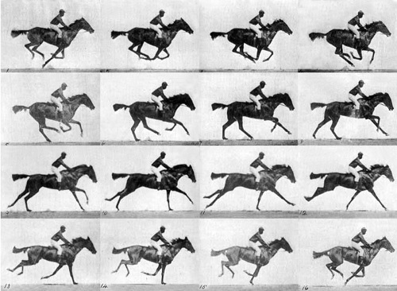
Time-resolved Spectroscopy
Eadweard Muybridge
The Horse in Motion (1872)

Slide 12
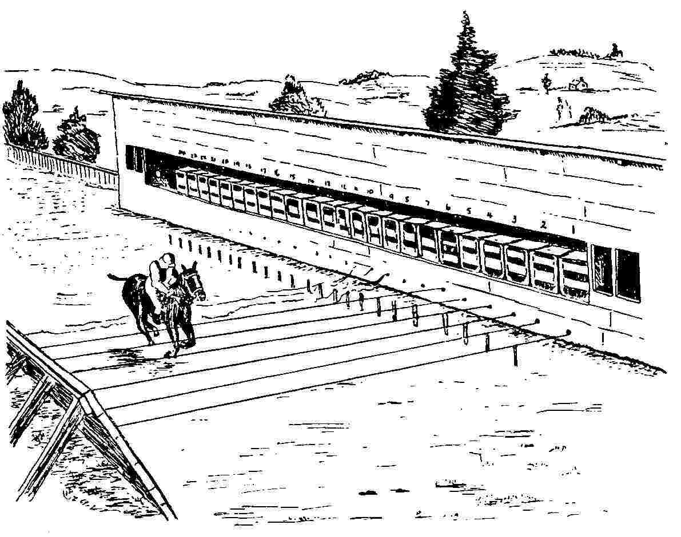
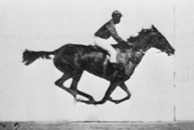
Time-resolved Spectroscopy
Muybridge was able to record events on the scale of about 0.001 second in 1877
1 ms time resolution!

Slide 13
Spectroscopy Timeline
150 years = 17 orders of magnitude
17 orders of magnitude (bacteria vs. size of the solar system)

Slide 14
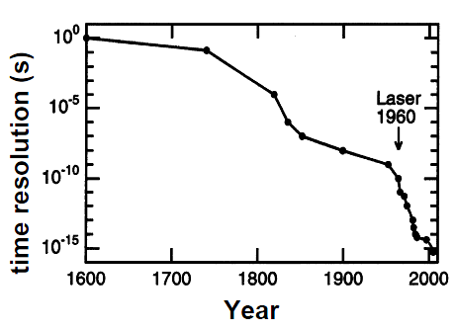
Time-Resolved Timeline

Slide 15
Transient Absorption Spectroscopy
Source
Source
hν
Detector
hν
Sample
Transient Absorption (Pump-Probe Experiment)
1) High intensity pulse of light.
2) Monitor absorption spectrum over time.

Slide 16
Transient Absorption Spectroscopy
Electron Transfer Dynamics
hν
A
C
A
C*
A⁻
C⁺

Slide 17
Transient Absorption Spectroscopy
Electron Transfer Dynamics
A
C
A
C*
A⁻
C⁺

Slide 18
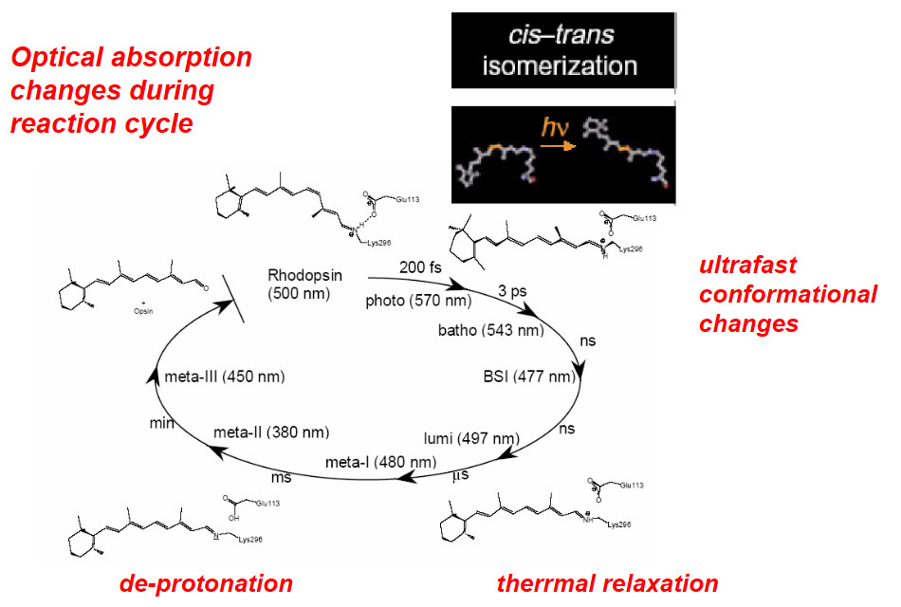
Transient Absorption Spectroscopy

Slide 19
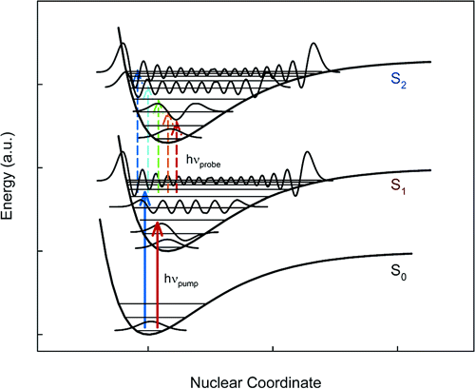
Transient Absorption Spectroscopy
C
C*
Excited State Absorption Spectra
1) Excitation (hν_{pump})
2) Absorption Spectra (hν_{probe})

Slide 20
Basics of TA Measurement
Source
(2)
Events:
1) Absorption Spectra
2) Excitation Flash
3) Absorption spectra
Source
hν
Detector
hν
(1)
(3)
Sample
(1)
(3)
Excited State
Ground State
pump
probe
probe
probe
Time

Slide 21
Difference Spectra
S₁
4 excited states/100 molecules
E
hν
S₀
A for xS₀ molecules
A for (x - y)S₀ + yS₁ molecules

Slide 22
Difference Spectra
A(t) - A(0) = ΔA
A(0) = absorption without laser pulse
A(t) = absorption at time t after laser pulse
A(t)
A(0)
ΔA at time t
-
=
A for
(x - y)S₀ + yS₁
A for
xS₀
- yS₀ + yS₁

Slide 23
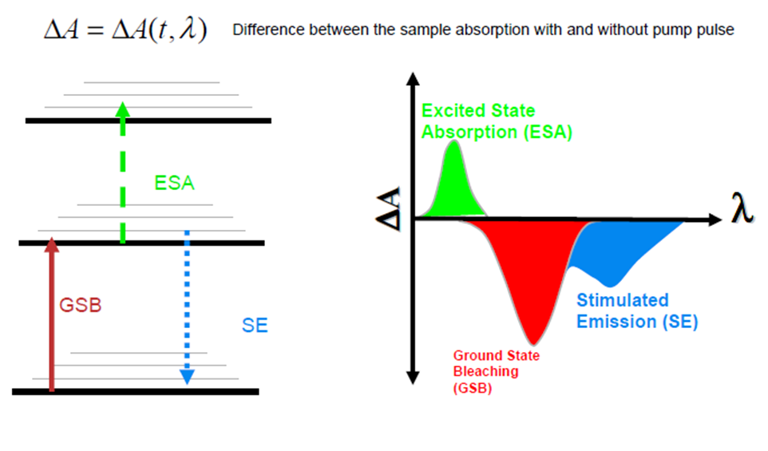
Difference Spectra
∝ S₁ generated
∝ S₀ lost
We don’t get to measure absorbance!

Slide 24
Difference Spectra
We measure transmittance!
Sample
Absorbance:
A = -log T = log P₀/P
P₀
P
(power in)
(power out)
A(t) - A(0) = ΔA
P₀(t)
P₀(0)
A(t) = log
A(0) = log
P(t)
P(0)
Probe source
is the Same
P₀(t) = P₀(0)
P(0) = power out before pump
P(t) = power out after pump
P(0)
Then:
ΔA = log
P(t)

Slide 25
TA Measurement
Source
(2)
Events:
1) Measure P(0)
2) Pump
3) Measure P(t)
Source
hν
Detector
hν
(1)
(3)
Sample
(1)
(3)
P(0)
P(0) = power out before pump
P(t) = power out after pump
ΔA = log
P(t)

Slide 26


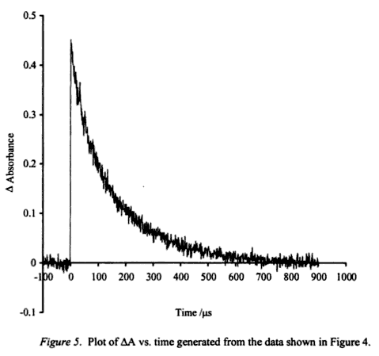
TA Measurement
Full spectra detection
Single λ detection
Pump
Pump
Detector
Detector
hν
hν
Probe
Probe
hν
hν
Sample
Sample

Slide 27
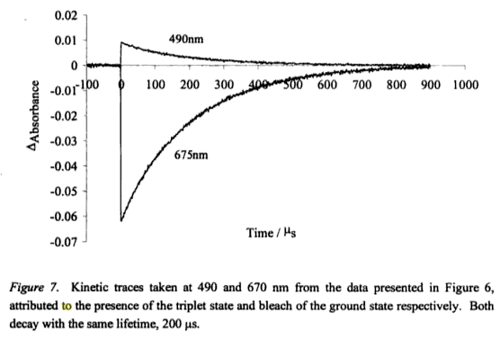
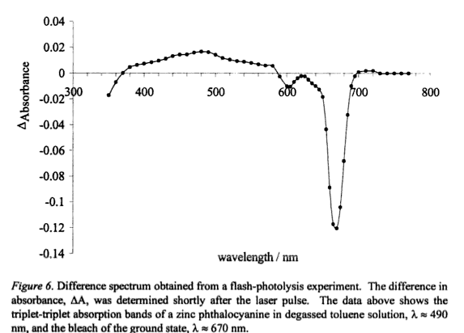
Single Wavelength to Full Spectrum
Single Wavelength
Full Spectrum Data

Slide 28
Events in Time
Photochemistry
Isomerization
Excitation
Intersystem Crossing
Fluorescence
Phosphorescence
Internal Conversion
1 fs
1 ps
1 ns
1 μs
1 ms
1 s
femto
pico
nano
micro
milli
seconds
Nanosecond TA
Femtosecond TA
Picosecond TA
Attosecond TA

Slide 29


Nanosecond TA (10⁻⁹ s)
Source
Source
hν
Detector
hν
Sample
First developed in the 1950s (Eigen, Norrish and Porter)
1967 Nobel Prize in Chemistry “for studies of extremely fast chemical reactions, effected by disturbing the equilibrium by means of very short impulses of energy”

Slide 30
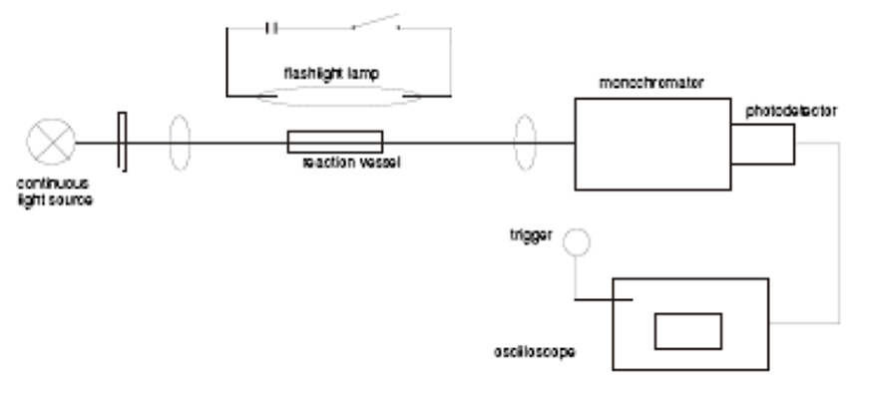
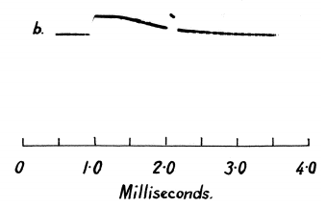
Nanosecond TA (10⁻⁹ s)
high-intensity photography lamp
1 m quartz tube
Photomultiplier tube
Tungsten lamp

Slide 31
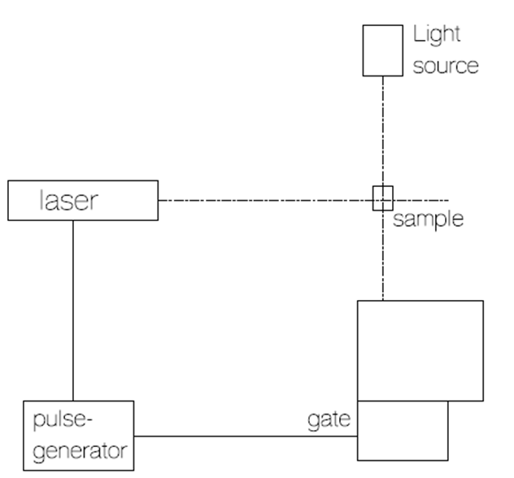
Nanosecond TA (10⁻⁹ s)
Xe Flash Lamp
Q-switch laser
Nd:YAG, Ar Ion
<10 ns pulsewidth
Mono-
chrometer
PMT

Slide 32
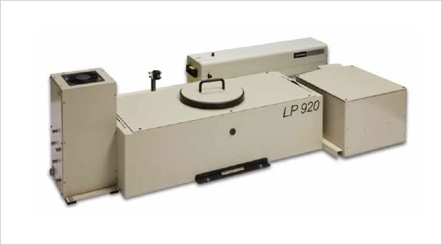
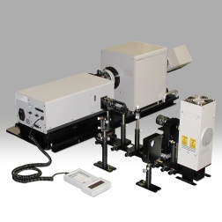
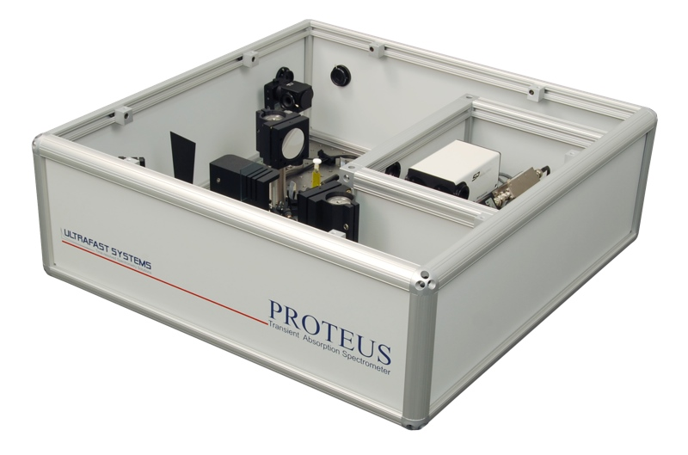
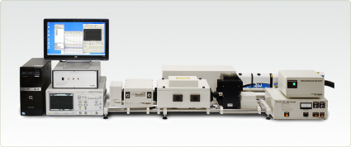
Commercial Nanosecond TA systems
Edinburgh-LP920
Hamamatsu-F157
Ultrafast Systems-Proteus
Applied Photophysics- LKS80

Slide 33
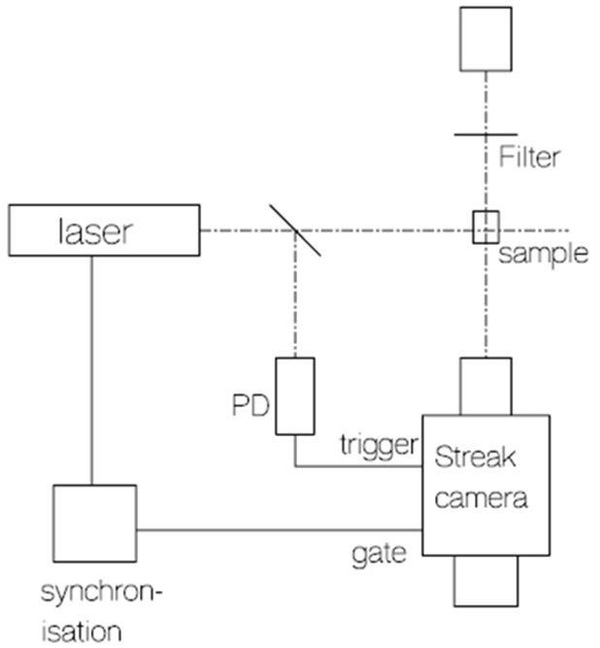
Picosecond TA (10⁻¹² s)
Flash Lamp
Or picosecond white-light continua
Mode-locked Laser

Slide 34
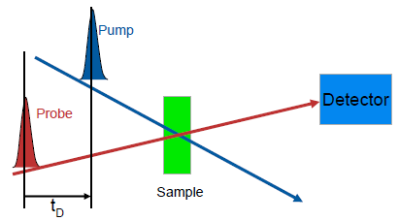
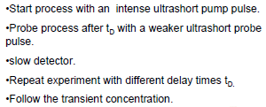
Femtosecond TA (10⁻¹⁵ s)
First developed in the 1980s (A. H. Zawail)
1999 Nobel Prize in Chemistry “for his studies of the transition states of chemical reactions using femtosecond spectroscopy"

Slide 35
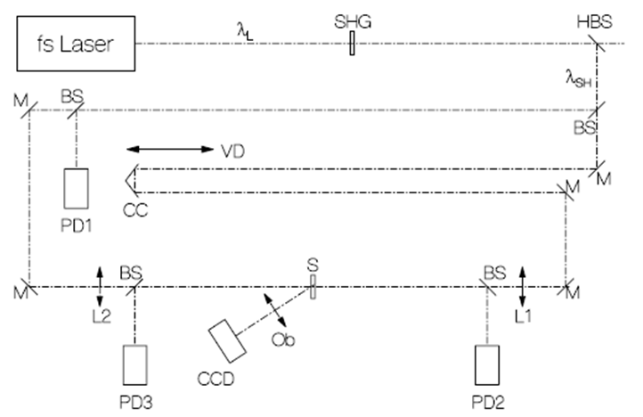
Femtosecond TA (10⁻¹⁵ s)
(1)
Pump
(2)
Probe
(3)
Delay Stage
(4)
Detector
1) Femtosecond laser pulse
2) Beam splitter (into Pump and Probe)
3) Probe Travels through Delay Stage
4) Pump hits sample (exciation)
5) Probe hits sample
6) Transmitted Probe hits detector

Slide 36
Femtosecond TA (10⁻¹⁵ s)
ΔA = log P(0)/P(t)
Pump
Graph of t vs ΔA
Transient Concentration
Intensity
ΔA
time
time
blank P(0)
pump
probe
Transmitted Light at time 1
P(t1)
Intensity
t_{d1}
P(t)
time
time
pump
probe
Transmitted Light at time 1
P(t2)
Intensity
t_{d2}
Intensity
time
time

Slide 37
Femtosecond TA (10⁻¹⁵ s)
P(t) < P(0)
ΔA = log P(0)/P(t)
P(t) > P(0)
blank P(0)
blank P(0)
pump
pump
probe
probe
Intensity
t_{d1}
Intensity
t_{d1}
time
time
Decrease Transmitted light P(t)
Increased Transmitted
light P(t)
P(t)
P(t)
time
time
Graph of t vs ΔA
Graph of t vs ΔA
ΔA
ΔA
time
time
New species after laser pulse.
Loss of species after laser pulse.

Slide 38
Single Wavelength to Full Spectrum
Single Wavelength
Full Spectrum Data

Slide 39
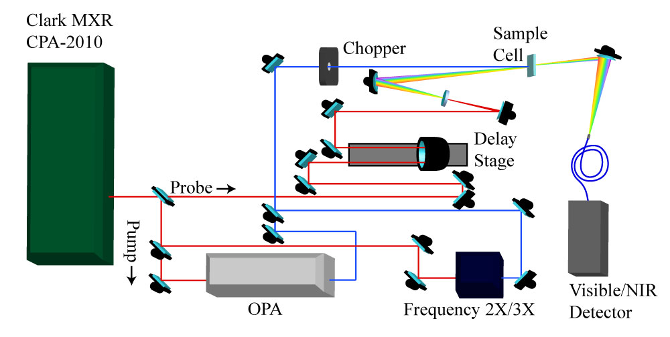
Femtosecond TA (10⁻¹⁵ s)

Slide 40
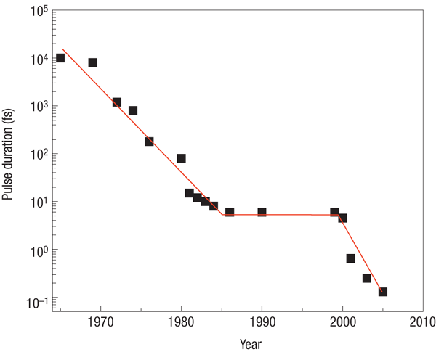
Attosecond Spectroscopy (10⁻¹⁸ s)
“However, the resolution offered by femtosecond spectroscopy is insufficient to track the dynamics of electronic motion in atoms or molecules since they evolve on an attosecond (1 as = 10−18 s) to few-fs time scale and thus remain elusive so far.”
6-fs pulse
300 attosecond pulse
Nature Physics 3, 381 - 387 (2007)

Slide 41
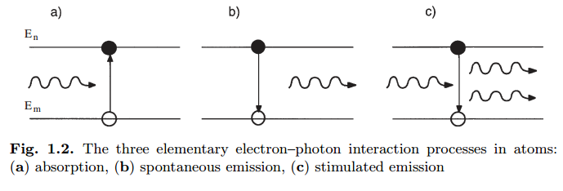
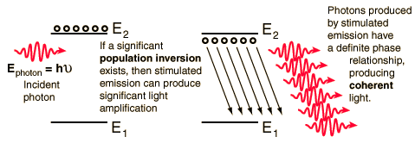
Nano-femtosecond TA
Light Amplification by Stimulated Emission of Radiation

Slide 42
Nano-femtosecond TA
Light Amplification by Stimulated Emission of Radiation
Mode-Locking Lasers
Light Sources
Gain medium
Mirrors
I
I₀
I₁
I₃
Laser medium
I₂
R = 100%
R < 100%
R. Trebino

Slide 43
Pico-femtosecond TA
http://www.youtube.com/watch?v=efxFduO2Yl8

Slide 44
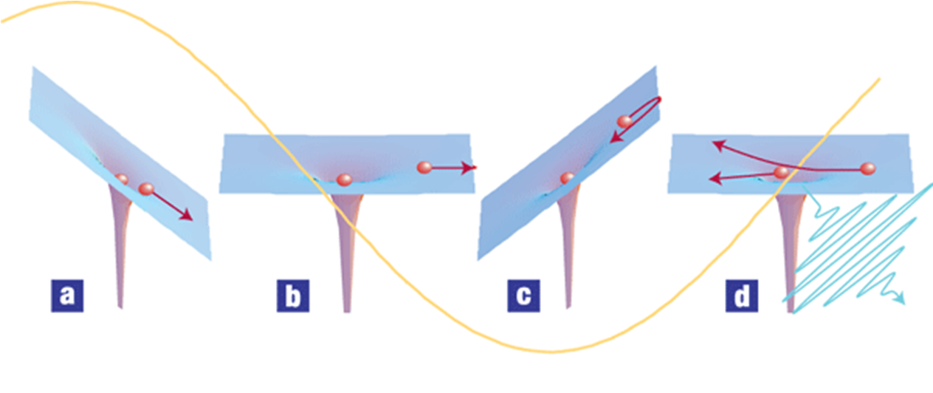
Attosecond TA
a–d, An intense femtosecond near-infrared or visible (henceforth: optical) pulse (shown in yellow) extracts an electron wavepacket from an atom or molecule. For ionization in such a strong field (a), Newton's equations of motion give a relatively good description of the response of the electron. Initially, the electron is pulled away from the atom (a, b), but after the field reverses, the electron is driven back (c) where it can 'recollide' during a small fraction of the laser oscillation cycle (d). The parent ion sees an attosecond electron pulse. This electron can be used directly, or its kinetic energy, amplitude and phase can be converted to an optical pulse on recollision.

Slide 45
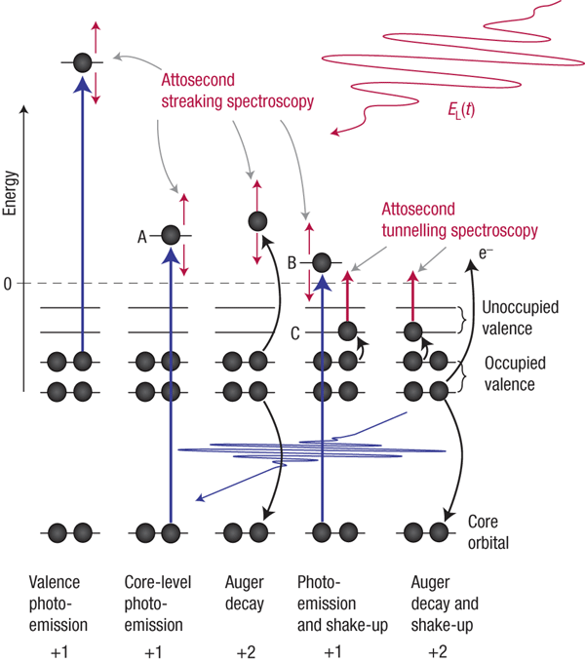
Attosecond TA
Electronic excitation and relaxation processes in atoms, molecules and solids, and possible ways of tracing these dynamics in real time.

Slide 46
Attosecond Spectroscopy
“However, the resolution offered by femtosecond spectroscopy is insufficient to track the dynamics of electronic motion in atoms or molecules since they evolve on an attosecond (1 as = 10−18 s) to few-fs time scale and thus remain elusive so far.”
6-fs pulse
300 attosecond pulse
Nature Physics 3, 381 - 387 (2007)

Slide 47
Transient Absorption End
Any Questions?

